Slide 1
PHP MySQL Project Design
Made By:
Tanu Bhutani
Shubhra Shree
Abhishek Khanna

Slide 2
Version (By) | Date
1.0 (Tanu, Shubhra, Abhishek) | 20-Nov-2018
1.1 (Amit) | 21-Nov-2018
Author(s) | Shubhra, Tanu and Abhishek
Moderators | Awanish, Amit, Priyamvada, Tripti

Slide 4
Sign-Up Page

Slide 5
LOGIN / SIGN UP
Email-Id *
First Name *
Last Name *
D.O.B *
Address *
Line 1 *
Line 2
CITY *
STATE *

Slide 6
SIGN-UP Page Contd…
Pin Code *
Password *
Confirm Password *
Fields Marked with * are mandatory!
REGISTER

Slide 7
Sign-Up Success Scenario
(User Dashboard)

Slide 8
Social Vibes
SIGN OUT
Welcome ABC
EDIT
Address:
Birthday:

Slide 9
Login Page

Slide 10
LOGIN / SIGN UP
Username
Password
Forgot your password?
LOGIN

Slide 11
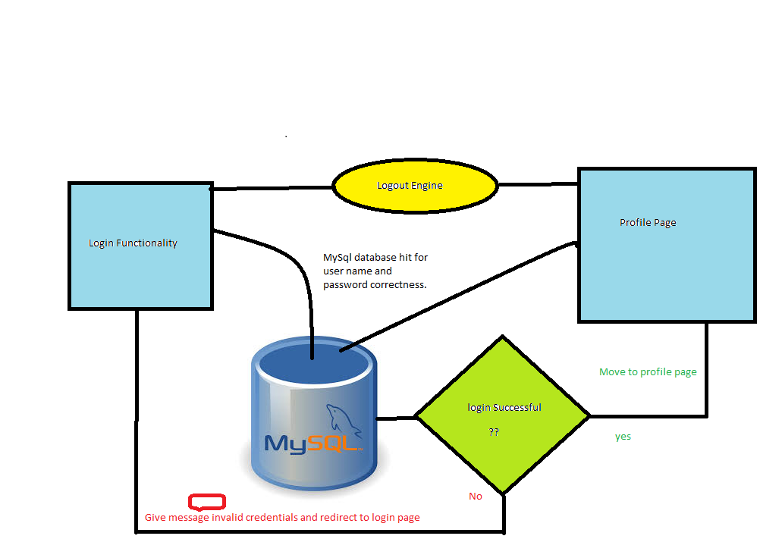
Architecture

Slide 12
Login Failure Scenario

Slide 13
LOGIN / SIGN UP
Invalid Credentials !
Username
Password
Forgot your password?
LOGIN

Slide 14
Login Success Scenario
(User Dashboard)

Slide 15

Social Vibes
SIGN OUT
Welcome ABC
EDIT
Address:
Birthday:

Slide 16
Forget Password Scenario
(Details Verification Page)

Slide 17
Verify Your Details
email
D.O.B
SUBMIT

Slide 18
Verification Failure Scenario

Slide 19
Verify Your Details
Record not found !
Email
D.O.B
SUBMIT

Slide 20
Verification Success Scenario
(Change Password Page)

Slide 21
Change Your Password
New Password
Confirm New Password
SUBMIT

Slide 22
Password Change Success Page

Slide 23
Your Password Has Been Changed!
Click Here To Login

Slide 24
Thank You!

